Slide 1
UNFOLDINGWORD · DESIGN SYSTEM
Generative Glass
A liquid-glass design language: translucent surfaces over a soft aurora field, tuned to the unfoldingWord palette.
GENERATIVE GLASS
APRIL 2026

Slide 2
01
SECTION 01
Foundations
Colour, type, glass, depth and motion — the five decisions everything else inherits.
GENERATIVE GLASS
02

Slide 3
WHAT IS IN THE SYSTEM
Built once, inherited everywhere
224
21
2
Design tokens, from the glass fill ladder to the motion curves
Components — ten core primitives, eleven in the example app
Complete themes; components read aliases and go dark unchanged
GENERATIVE GLASS
03

Slide 4
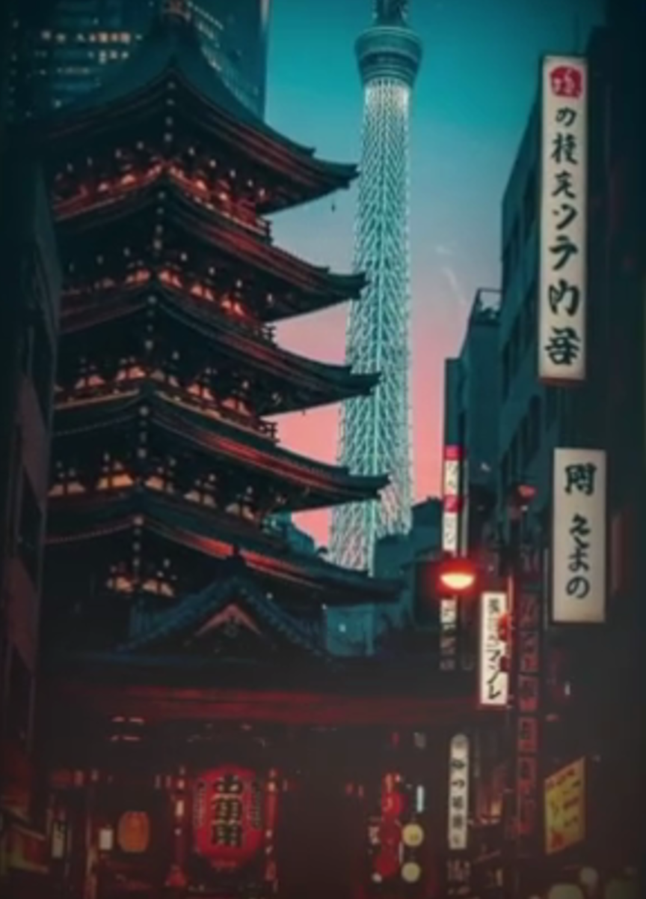
THE MATERIAL
Every surface is glass
Four fill steps and five blur steps, always with saturate(160%).
A 0.5px white hairline, an inner top light, and a three-layer Ocean shadow — all three, always.
Blur only where a surface floats over content it does not own.
GENERATIVE GLASS

Slide 5
The brand is not a layer on top of the glass. It is the glass.
Visual foundations, readme.md
GENERATIVE GLASS
05

